Slide 1
Blood as a Mixture

Slide 2
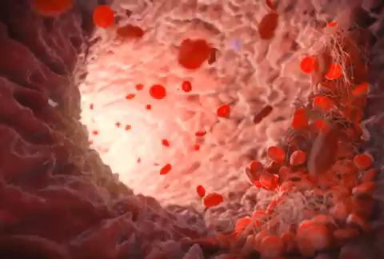
By the end of this lesson you should be able to:
Describe the four components of blood.
Explain how blood is separated into its components.

Slide 3
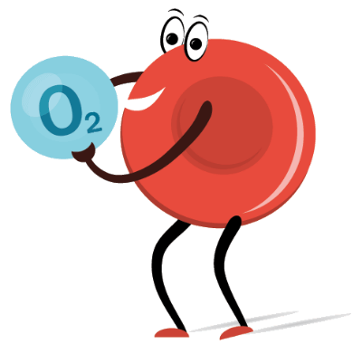
One of the most important parts of your body is your blood.
It takes oxygen from your lungs and nutrients from your digestive system and carries them to every part of your body.
This is how your body keeps itself running.

Slide 4
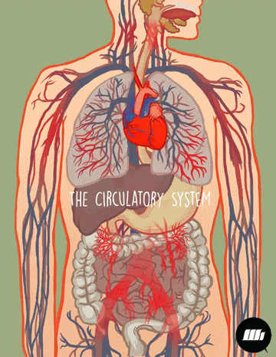
Blood also helps to fight infections, remove waste from parts of the body and works to block cuts when you are bleeding.
Given that it has so many diverse functions, it makes sense that blood is a mixture of different components. Blood is transported around the body by the cardiovascular system, which is driven by the heart pumping.

Slide 5
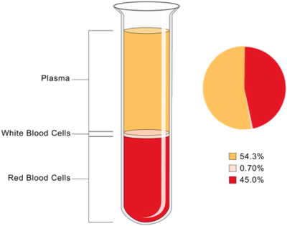
As a mixture, blood is made up of four different substances: plasma, red blood cells, white blood cells and platelets.
The red blood cells, white blood cells and platelets are all suspended in plasma. The cells and platelets in blood are made in our bone marrow - the spongy substance at the centre of our bones.
While blood is a suspension, it also does not separate out after standing for a very long time, which makes it a colloid.

Slide 6
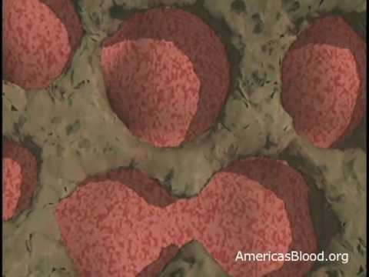

Slide 7
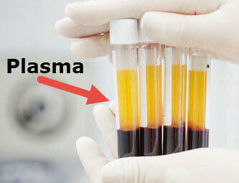
The components of blood are suspended in a solution called plasma.
Plasma is a yellow fluid that makes up 55% of the volume of blood. Water makes up the majority of plasma, with the rest being dissolved proteins, sugars and nutrients.
Plasma also carries carbon dioxide from all parts of the body to the lungs to be breathed out.

Slide 8
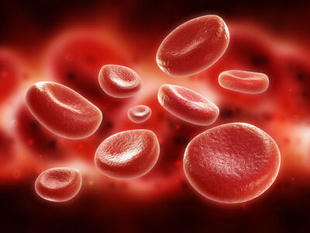
Oxygen in our blood is carried from the lungs to the rest of the body by red blood cells.
These are tiny flattened disks which give our blood its red colour.
Our bodies are continually producing red blood cells to replace those in our blood vessels, which stop working after 120 days.

Slide 9
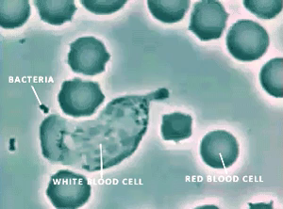
Your blood also fights off diseases!
It contains special cells called white blood cells that attack and remove anything that's not supposed to be in the blood.
They live shorter lives than red blood cells and there are less of them. But when you are sick, many more white blood cells are being produced to fight off the infection.

Slide 10
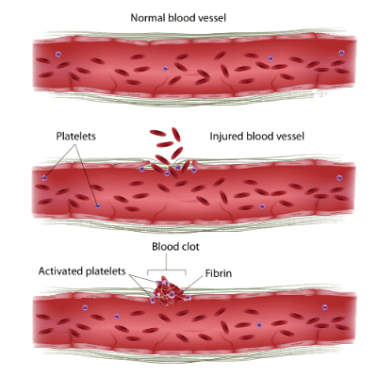
When you get a cut, you will notice that after a while it will have sealed with a scab.
Scabs are made by platelets - tiny cell fragments that are suspended in the plasma. Platelets cluster in any gaps or wounds in blood vessels and attempt to close the gaps. This is called clotting. The platelets form a seal (a scab) that stops blood from escaping. They are continually produced by the bone marrow as they only last a few days.

Slide 11
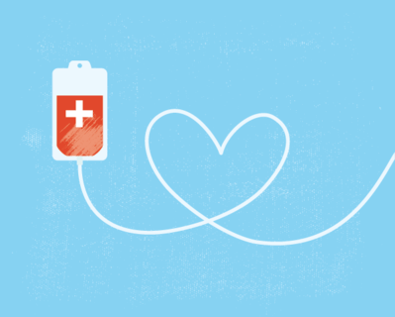
If you lose blood in an accident, or if you suffer from certain medical conditions, you may require a blood transfusion.
A transfusion is the process of receiving donated blood directly into the blood stream.
The blood is taken from the one million blood donations that are made each year in Australia.

Slide 12
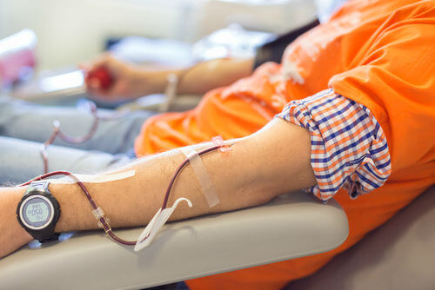
As we have seen, there are many different components in the mixture that is blood.
Different parts of the blood can be used to treat different conditions.
The Australian Red Cross Blood Service takes donations of blood to distribute to doctors nationally. They also separate the blood into its various parts; these parts can be used to treat different conditions and problems.

Slide 13
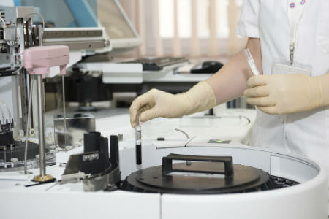
Blood is separated using a centrifuge.
This spins blood really quickly, using the force of the spinning to separate the components. Lighter parts of the mixture end up on top, with heavier parts on the bottom.
A centrifuge does not separate solutions, so the plasma itself is left unchanged.

Slide 14
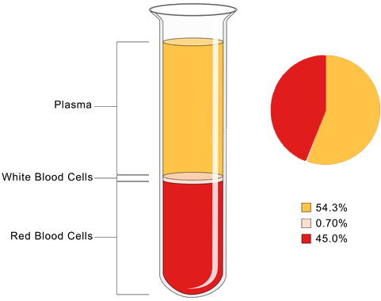
Blood is forced to separate into its components by the spinning centrifuge.
Blood cells and plasma are separated by the initial spin, and then further centrifuging or filtering separates the different types of blood cell.

Slide 15
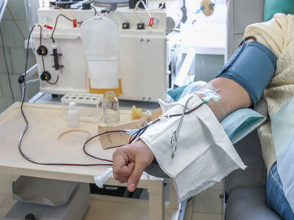
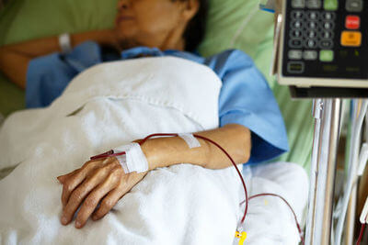
There are three forms of blood donation: plasma, platelet and whole blood.
Plasma donors give only the plasma from their blood. Blood is removed from the donor and passed through a centrifuge that separates the blood cells and plasma. The blood cells are then pumped back into the donor.
Platelet donation is very similar to plasma donation, except that the platelets are collected from the blood and the remaining cells and plasma are returned to the doner.
Whole blood donors give a set amount of blood, without the separation process, so it contains all components of blood. It is only later that the separation happens in a centrifuge.

Slide 16
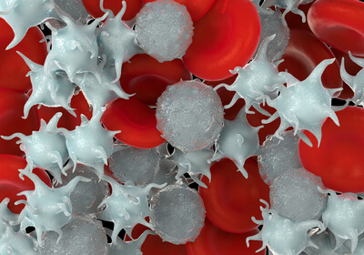
Blood is separated into two mixtures by centrifuging: plasma and platelets, and red and white blood cells.
The plasma and platelets can be centrifuged again, which will separate both products for use in different medical treatments.
Red and white blood cells are separated with filtration. White blood cells are not used, while red ones are used to treat blood loss.

